Slide 1

Servo control with Arduino and RTC
Krynytskiy Yuri
FeS-21
itlnu.lviv.ua

Slide 2
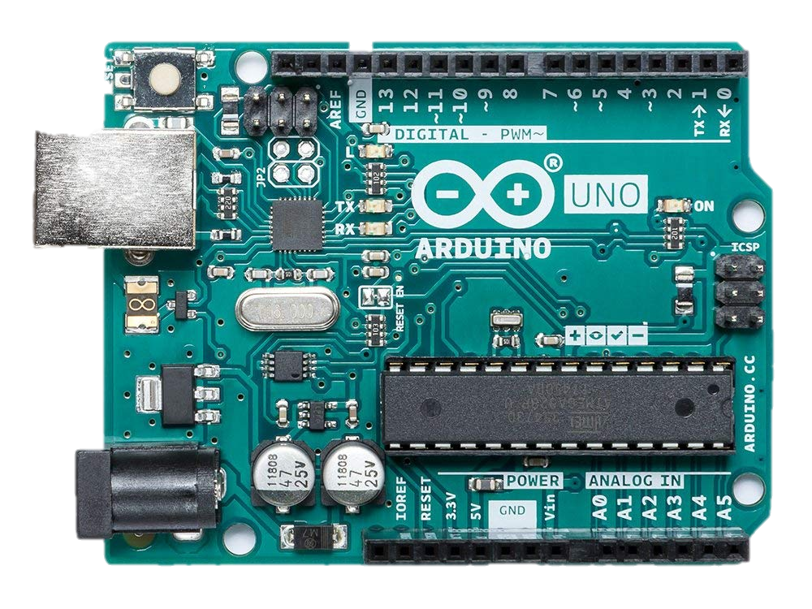
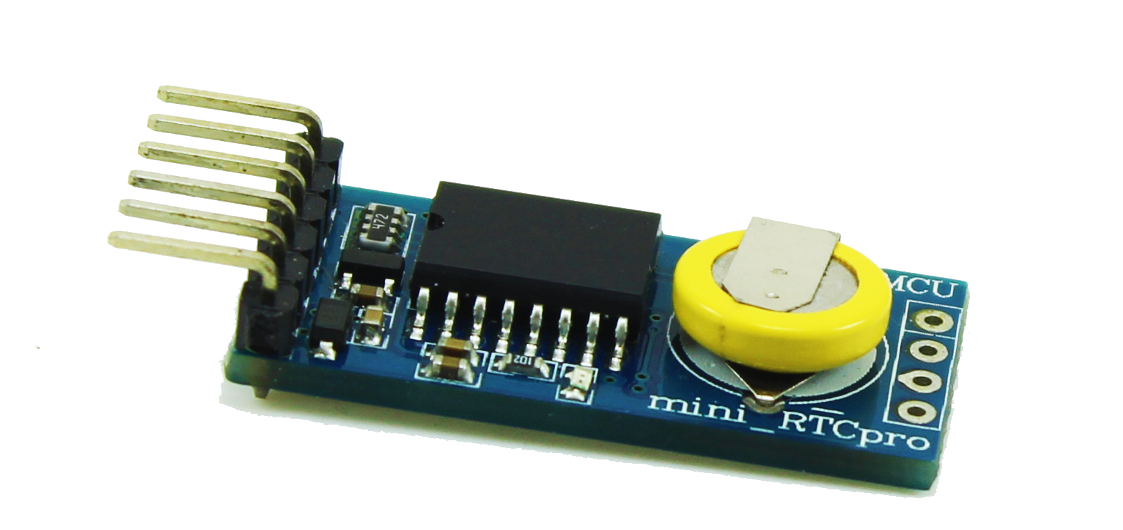
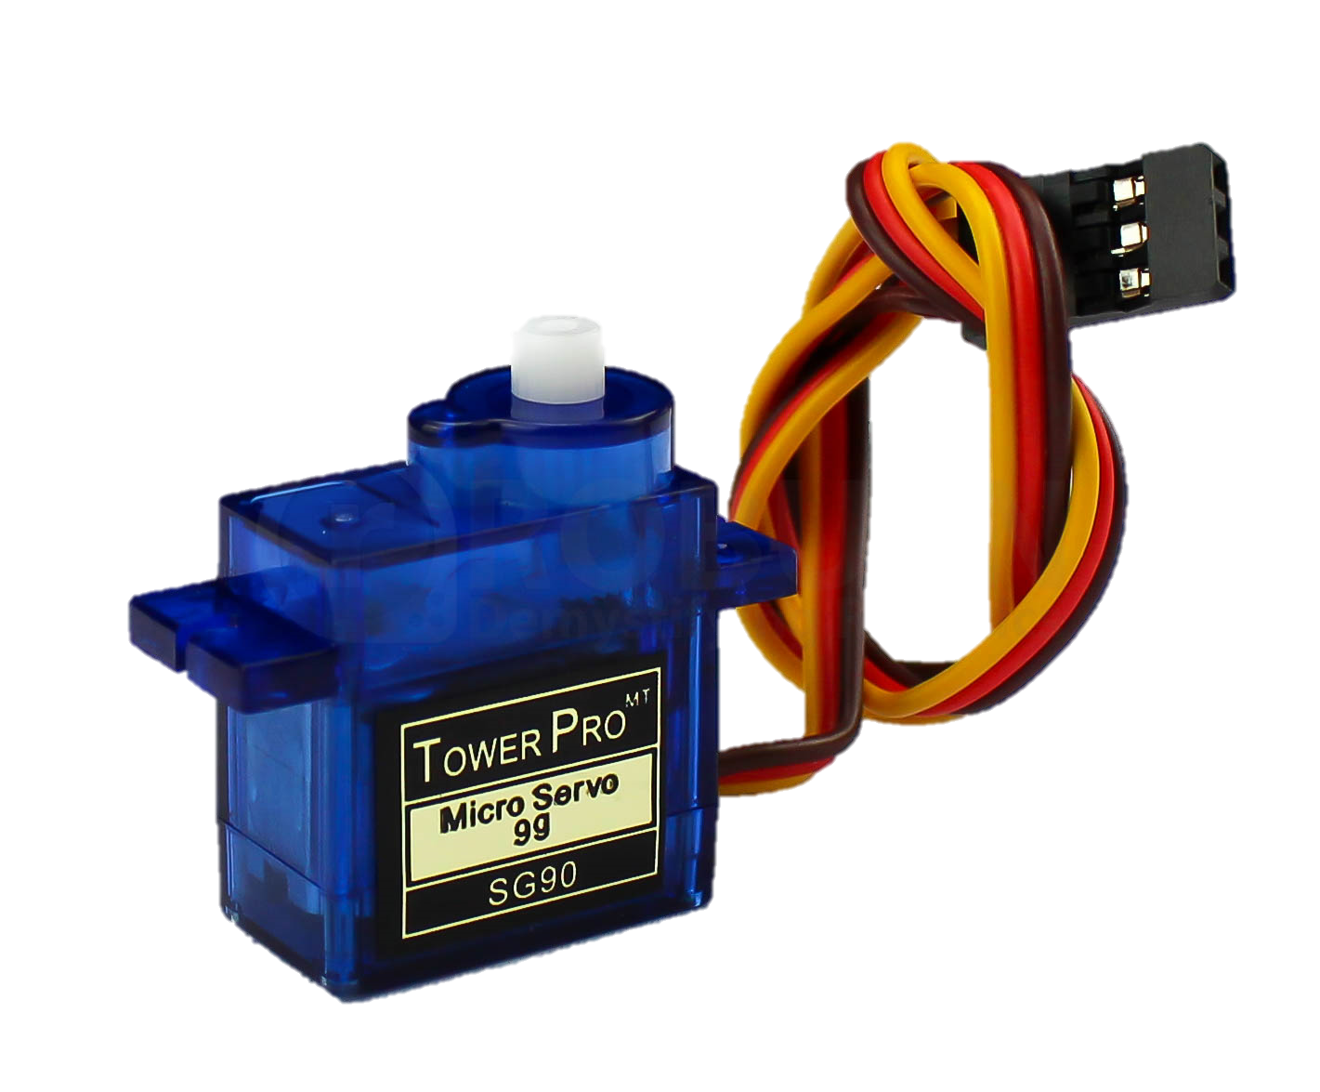
Used technologies and approaches
Arduino UNO;
RTC module;
Servo Drive;

Slide 3


Used technologies and approaches
Arduino IDE;
Fritzing;

Slide 4
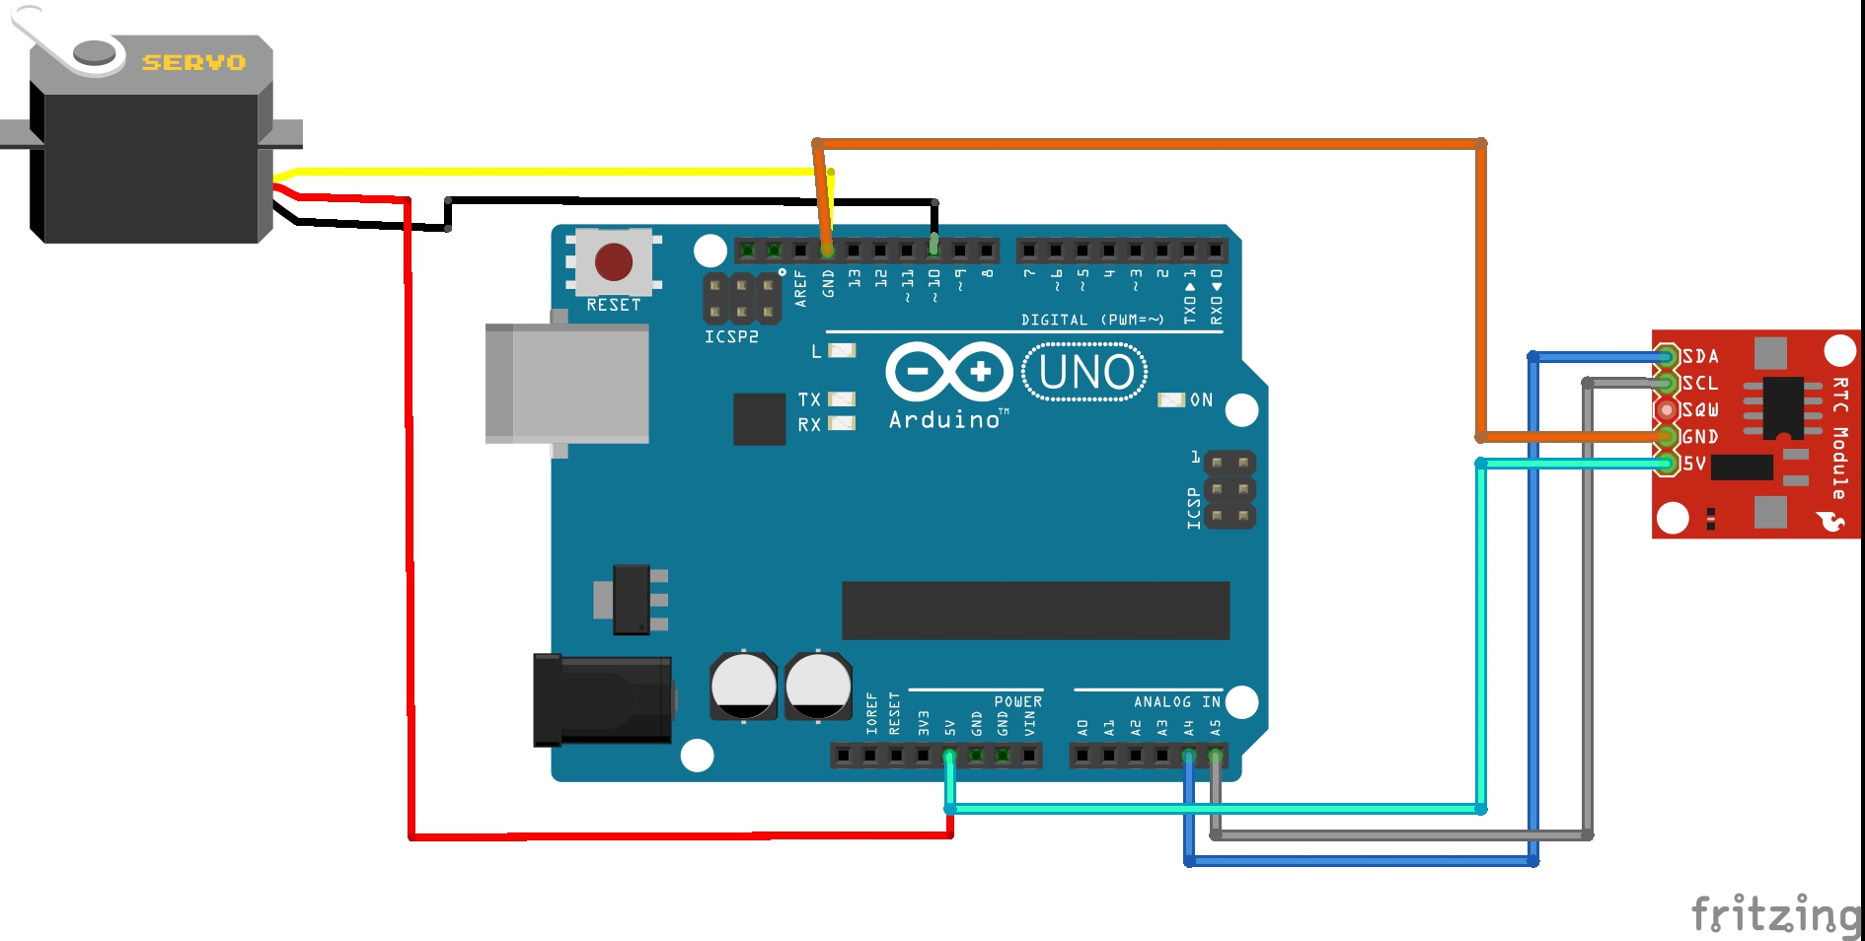
Connection scheme

Slide 5
Questions ?
Thank you for attention

